Slide 1
CASE STUDY | ARCHIVE MANAGEMENT
The Apulia Region is an autonomous institution with its own Statute and power, that collects, produces and reproduces a wide range of information and documents in many areas: economic, fiscal, social, geographical, touristic, etc.
THE APULIA REGION
© 2018 ICAM Srl. All rights reserved.

Slide 2
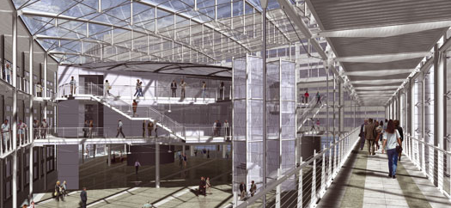
THE PROBLEM
The Apulia Region, as all the other Italian Public Institutions, is obliged to respect the articles 822 and 824 of the Italian Civil Code, which consider the archives and the public records as cultural heritage, regardless of their age, type, or content.
Therefore, all documents produced, received, or stored in any way by a public administration have a double nature of cultural goods and public acts.
In order to meet these regulatory requirements and ensure a better and more efficient document archiving, in 2013, the Apulia Region decided to move its departments to a brand new and larger building and designed a new organization of spaces dedicated to the documents storage.
KEY CHALLENGES:
An increasing number of paper documents.
Documents retained for a long time as required by regulatory requirements.
Protection of sensitive information whether held on paper documents or information displayed on PC monitors, etc. …
© 2018 ICAM Srl. All rights reserved.

Slide 3
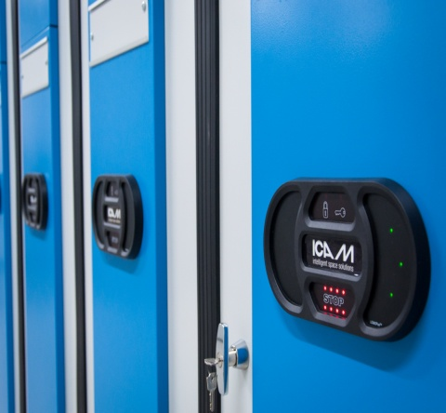
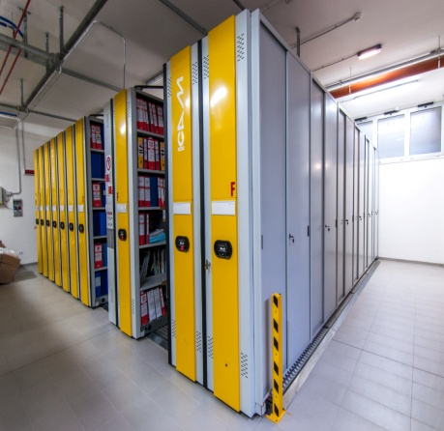
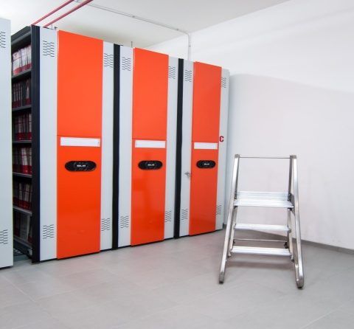
THE SOLUTION
320 motorized mobile bases COMPATTA ^{Light} have been installed to store paper documents and binders in the new building of the Apulia Region.
In order to differentiate the archives, every archiving system has been realized in different colors.
The opening of the aisle takes place by a control panel placed on the front of each mobile base. In case of a double entry solution, the control panel is also placed on the opposite side.
TECHNICAL DATA:
Model | Motorized
Items | Paper documents and binders
No. of bases | 320
Maximum load for base | 5,000 Kg
Dimensions (WxDxH) | 8,075-6,745 x 665 x 2,750 mm
Archive capacity | 26,700 lm
OBIETTIVI RAGGIUNTI:
Massimo sfruttamento dello spazio disponibile in presenza di pilastri
Controllo degli accessi e delle movimentazioni
Migliori condizioni di stoccaggio dei documenti archiviati
© 2018 ICAM Srl. All rights reserved.

Slide 4
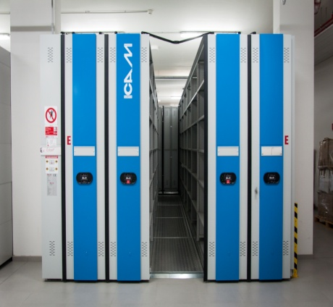
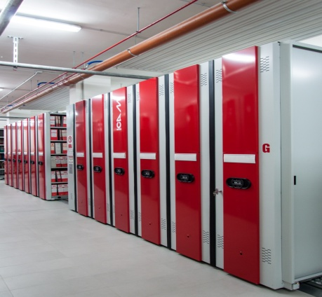
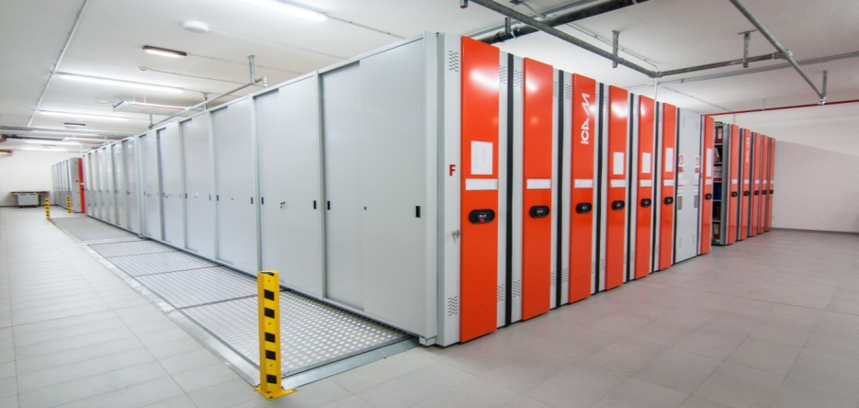
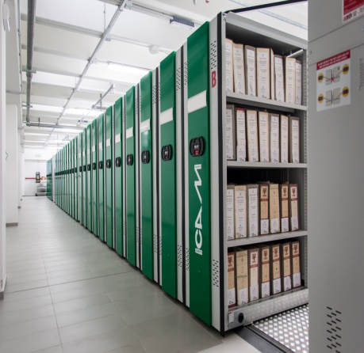
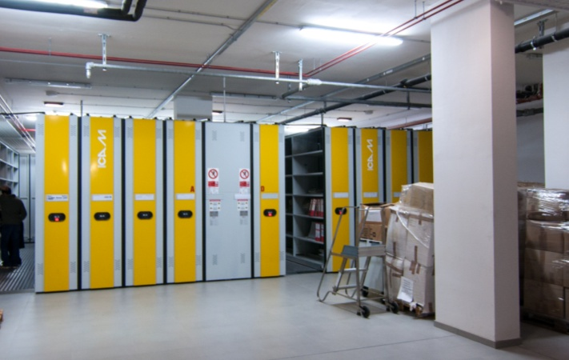
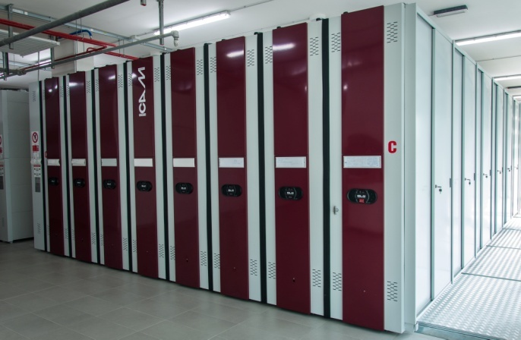
THE SOLUTION
KEY BENEFITS:
Easier identifications and quicker access to the archived documents
High level of protection of the documents from dust and unauthorized access
Maximum exploitation of space, even with pillars
© 2018 ICAM Srl. All rights reserved.

Slide 5
ICAM srl
S.P. 237 delle Grotte
70017 - Putignano (BA) ITALY
P.O. Box 129
Tel.: +39 080 4911377
Fax: +39 080 4911529
Info@icamonline.eu
© 2018 ICAM Srl. All rights reserved.

